Slide 1
DSA Final: Dynamic Elevator Simulation
Brandon Esebag
GitHub Repo: https://github.com/rancorjoy/ElevatorSimulator.git

Slide 2
Overview of all Classes (Main Data Structures)
MainWindow: Displays client window and updates each frame
AgentController: Controls the behavior of each agen
Agent: Controls the graphical output of each agent
ElevatorController: Controls the behavior of each elevator
ElevatorShaft: Controls the graphical output of each hall segment
ElevatorCar: Controls the graphical output of each elevator car

Slide 3
MainWindow Internal Data Structures
Constant Integers for MaxFloors, MaxShafts and MaxAgents to bound the simulation resources (allowing arrays to be used, cheaper for performance)
Resulting Arrays:
ElevatorController elevatorControllers[MaxShafts]
ElevatorCar elevatorCars[MaxShafts]
ElevatorShaft elevatorShafts[MaShafts, MaxFloors]
AgentController agentControllers[MaxAgents]
Agent agents[MaxAgents]
These arrays store all elements being simulated, but since the simulation can be shrank we need to deal with all edge cases!

Slide 4
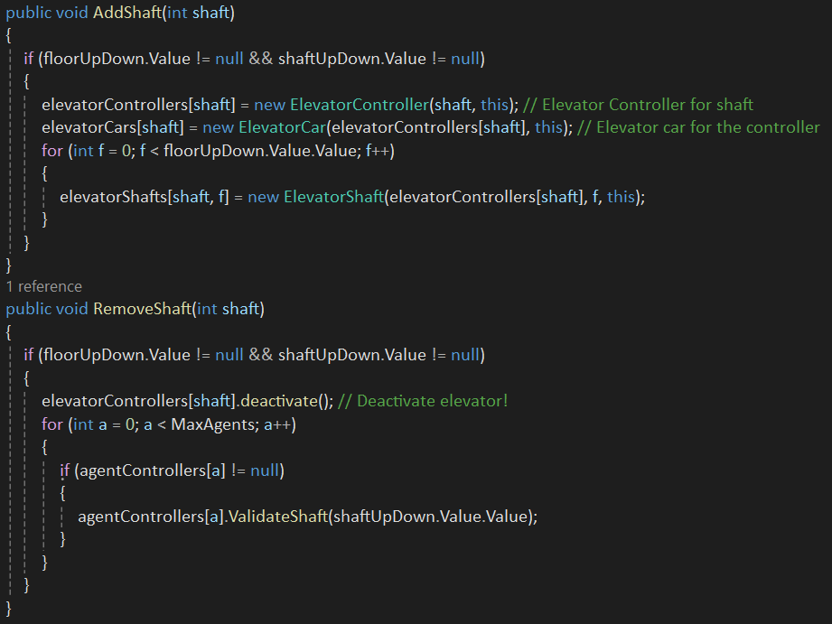
Add and Remove Shaft(s)
MainWindow:

Slide 5
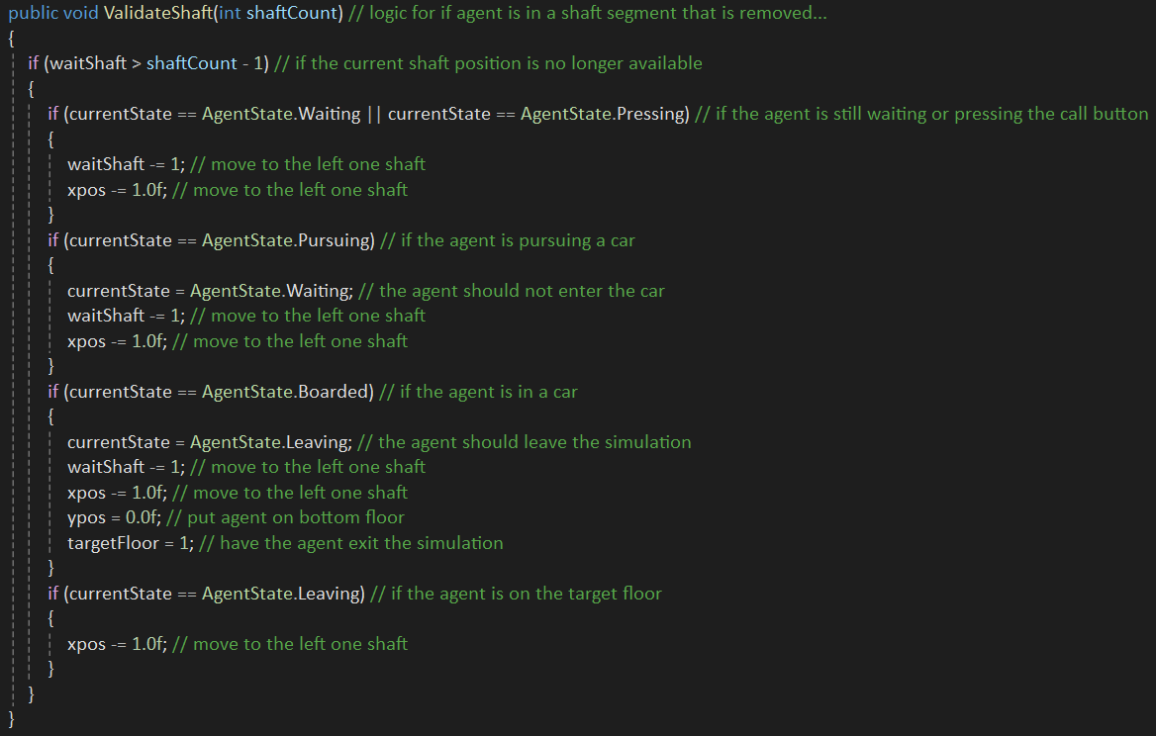
Remove Shaft(s) Continued
AgentController:

Slide 6
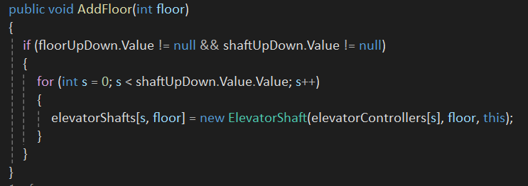
Add Floor(s)
MainWindow:

Slide 7
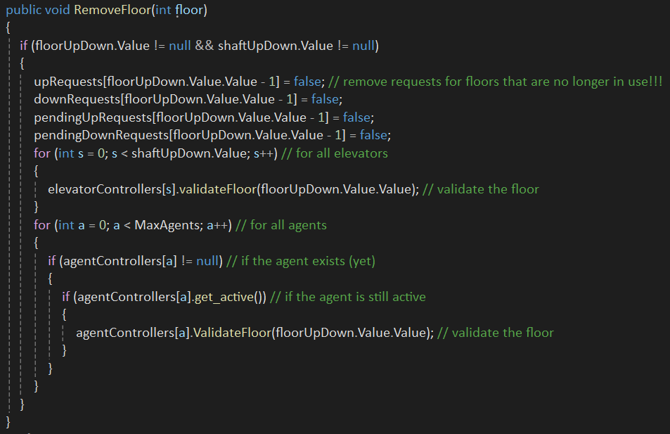
Removing Floor(s)
In MainWindow:

Slide 8
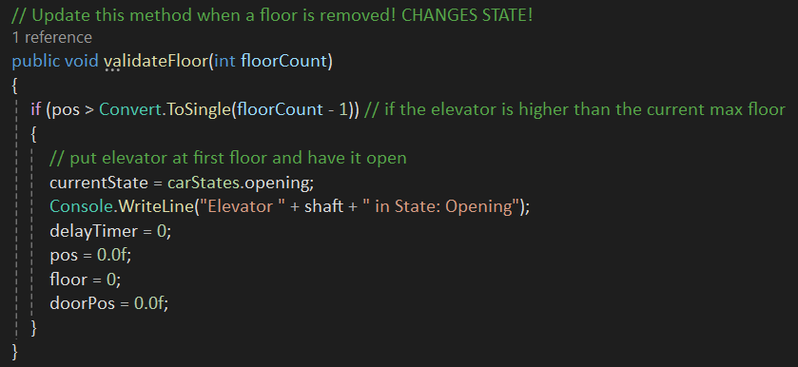
Removing Floor(s) Continued
In ElevatorController(s):

Slide 9
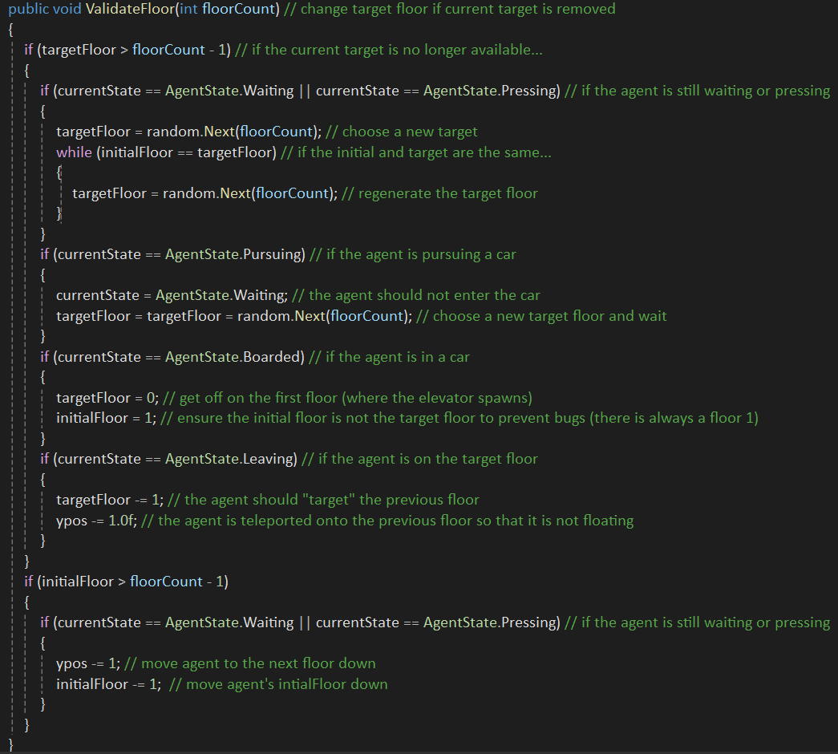
Removing Floor(s) Continued
In Agent(s):

Slide 10
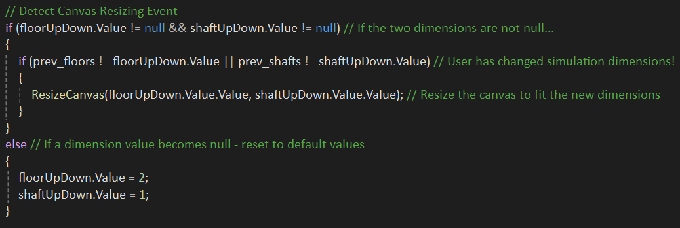
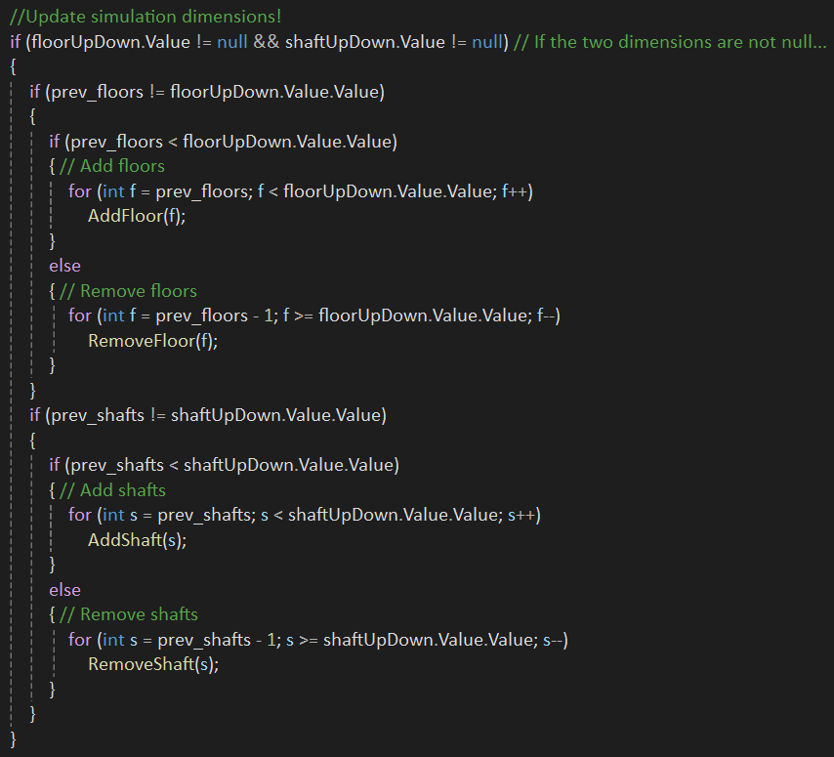
Changing Dimension Size (MainWindow MainLoop):

Slide 11
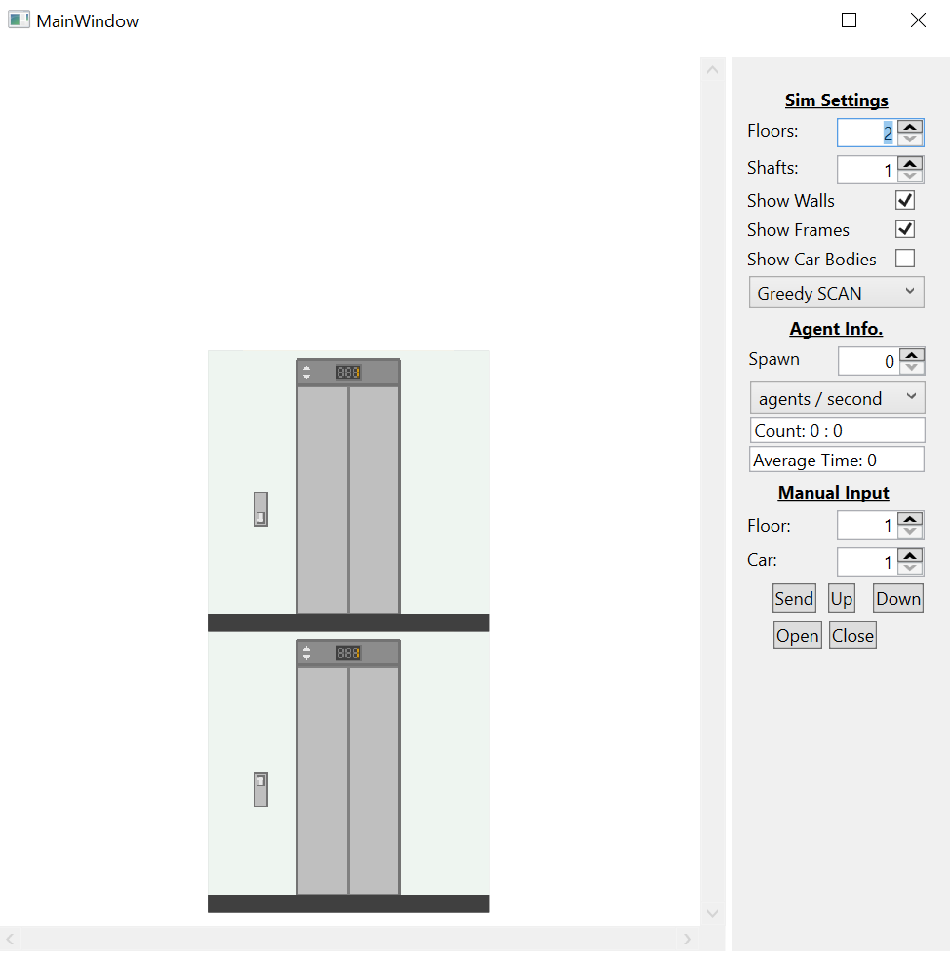
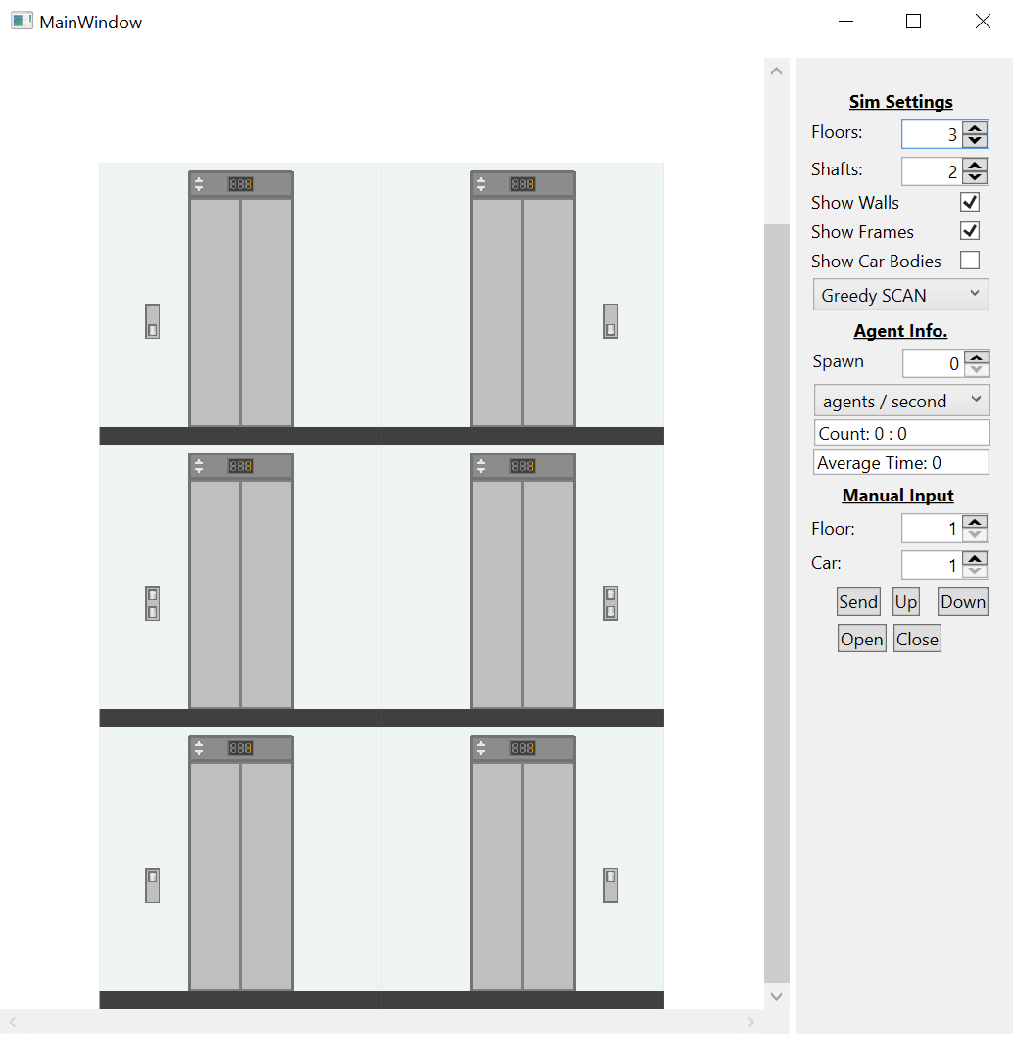
Changing the Simulation Size (User Interface):

Slide 12
Elevator Algorithms (SCAN Variants)
Greedy SCAN: Only uses idle elevators if there are no possible moving candidates (minimize idle calling).
Balanced SCAN: Scores each candidate based on distance and chooses the best candidate regardless of idle/moving state.
Aggressive SCAN: Only uses moving elevators if there are no possible idle candidates (maximized idle calling), exact opposite of Greedy SCAN.

Slide 13
Elevator State Machine (ElevatorController)
Nobody hit the open button or OpenTimer expired
Can be called from idle to a different floor
Moving
Idle
Opening
Nobody hit the open button or new target is current floor
Arrived at target
OpenTimer/2 expires
Nobody hit the open button
Open button
Doors are open
Idle_Closing
Open
Closing
Closed
Nobody hit the open button or OpenTimer expired AND there are no targets
Nobody hit the open button or OpenTimer expired
Nobody hit the open while closing (doors closed)

Slide 14
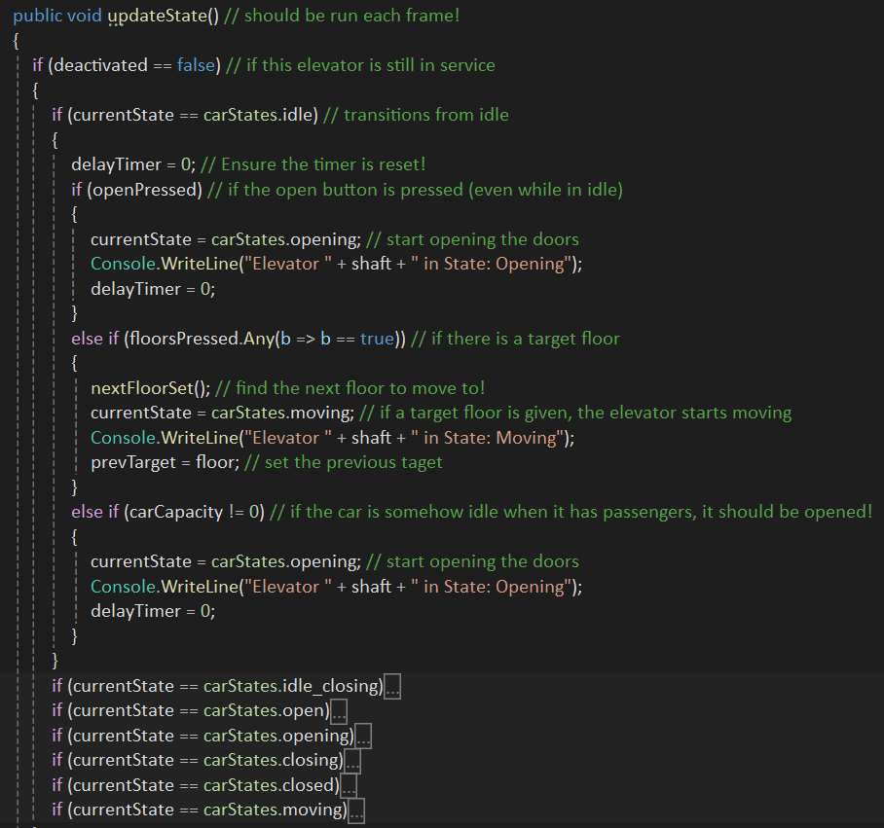
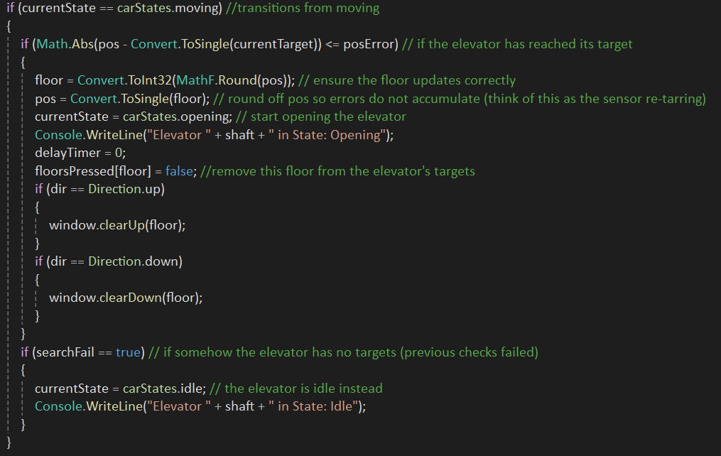
Elevator State Machine Transitions:

Slide 15
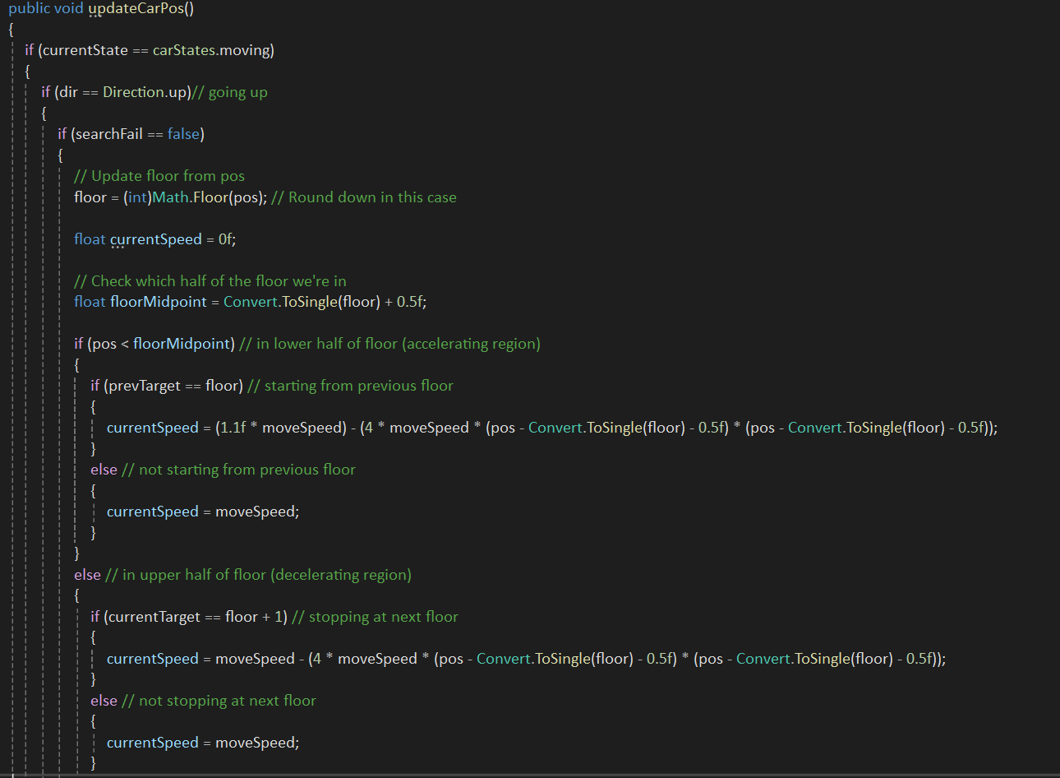
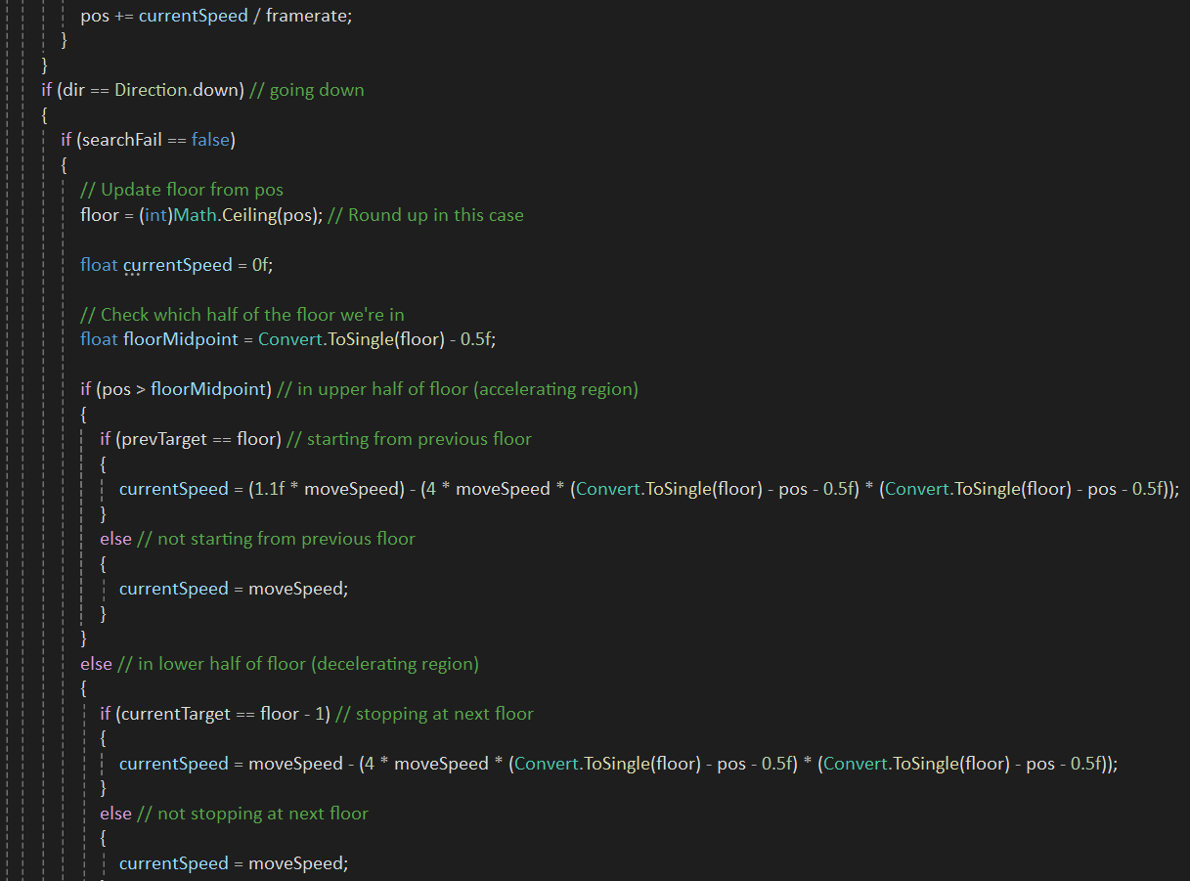
Elevator Door and Car Positions:
There is more… this is the main section

Slide 16
Agent State Machine (AgentController)
Waiting
Hall Button Pressed
Elevator has arrived
Pursuing
Pressing
Elevator missed or full
Elevator boarded
* Patience Timer ran out (press again)
Leaving
Boarded
Elevator arrived

Slide 17
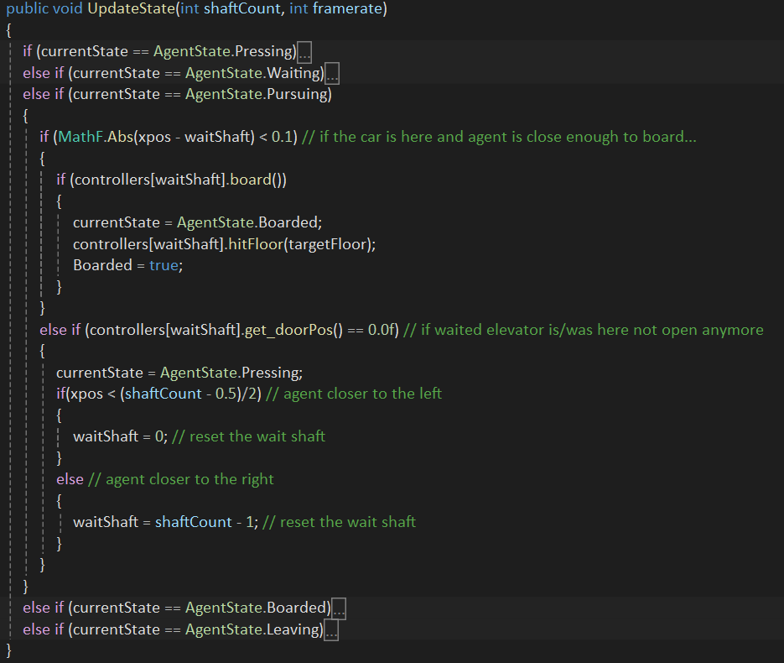
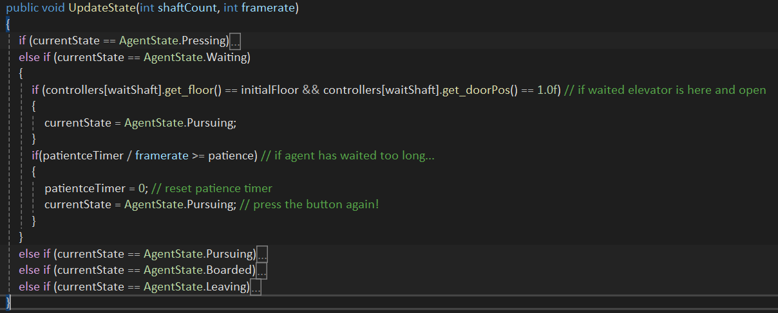
Agent State Transitions

Slide 18
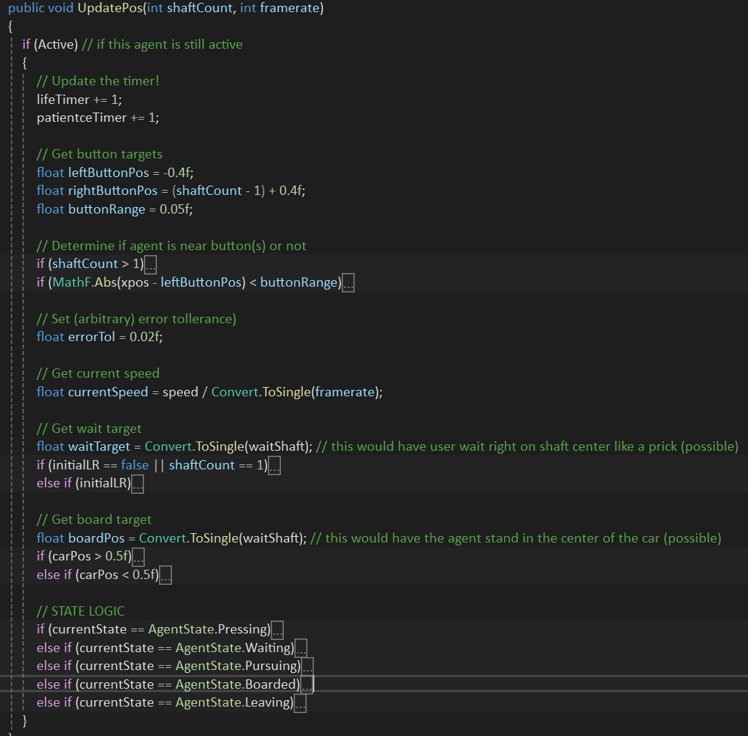
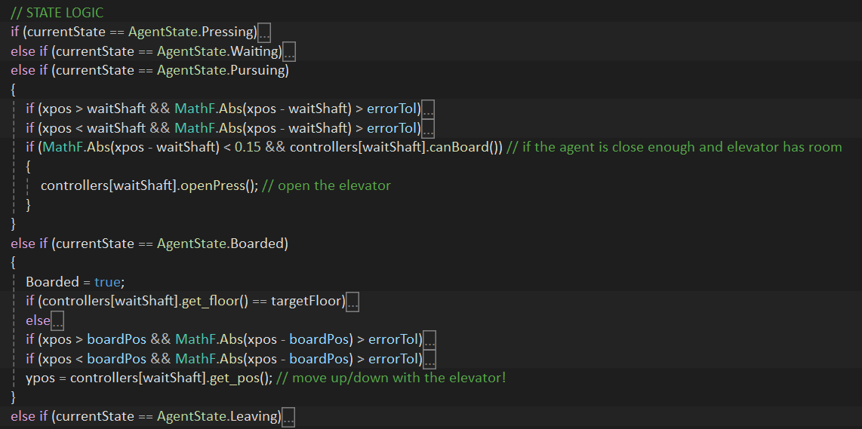
Agent Movement

